Slide 1


Predicting the Risk of Dementia
Garth Scheck

Slide 2
Why?
Cases are on the rise.
Seventh leading cause of death.
Financially devastating.

Slide 3
Data Source
National Alzheimer’s Coordinating Center
Thirty-three research centers
1024 Attributes
185,831 observations
Notes:
Challenges: using Google Colab

Slide 4
Data Cleansing
Elimination of attributes.
Elimination of null values.

Slide 5
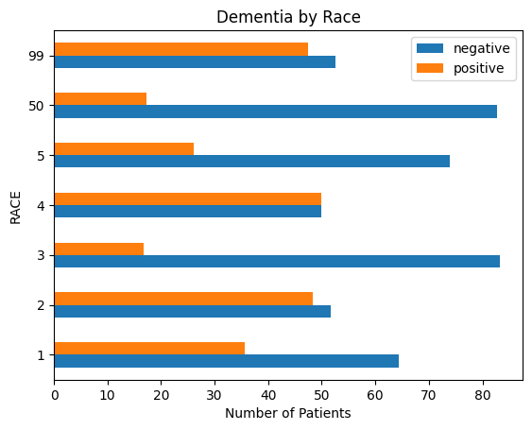
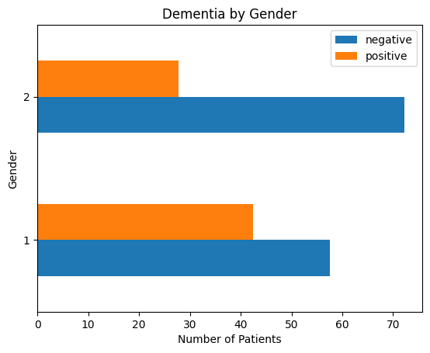
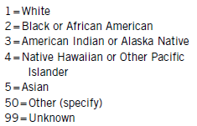
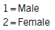
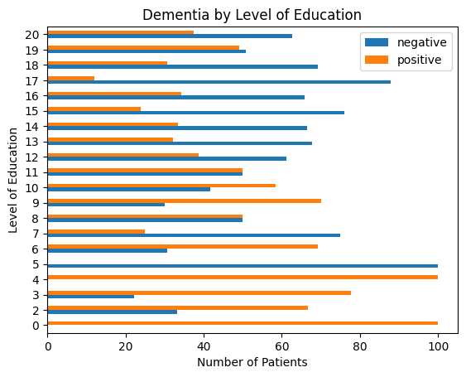
Demographics

Slide 6
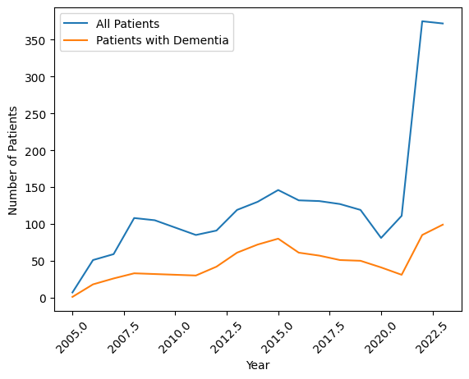
Dementia Numbers

Slide 7
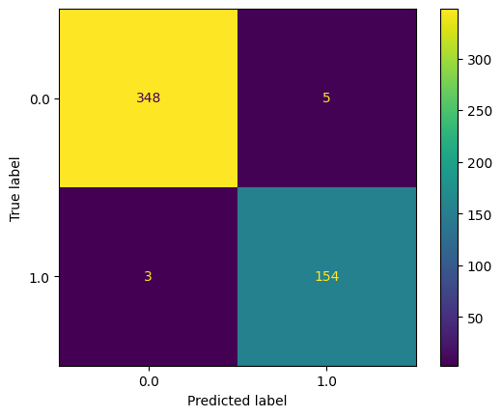
Machine Learning Models
Confusion Matrix
Model | Training Time | Accuracy %
Random Forest Classifier | 6 minutes | 98.43
Linear Discriminant Analysis | 44 seconds | 88.24
Logistic Regression | 1 seconds | 85.70
K Neighbors Classifier | 9 second | 78.43

Slide 8
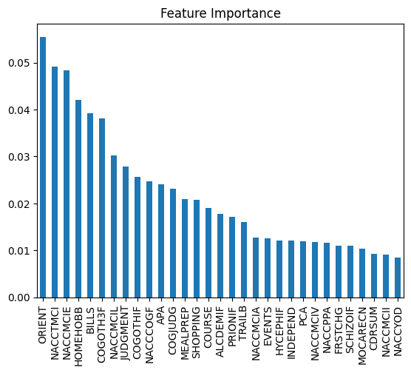
Feature Importance

Slide 9
Conclusion
Challenges.
ML as a viable approach.
Further Investigation

Slide 10
References
News, B. (2022, January 7). Dementia cases expected to almost triple across the world by 2050. BBC News; BBC News. https://www.bbc.com/news/health-59896819
How Much Does Memory Care Cost? (n.d.). National Council on Aging. https://www.ncoa.org/adviser/local-care/memory-care-costs/
‌Dementia becomes an emergency 1.4 million times a year. (n.d.). Ihpi.umich.edu. Retrieved March 22, 2024, from https://ihpi.umich.edu/news/dementia-becomes-emergency-14-million-times-year#:~:text=A%20busy%2C%20crowded%2C%20confusing%20emergency
Dementia and hospital overcrowding. (n.d.). The Irish Times. Retrieved March 22, 2024, from https://www.irishtimes.com/opinion/letters/dementia-and-hospital-overcrowding-1.2068746
National Alzheimer’s Coordinating Center | National Alzheimer’s Coordinating Center. (n.d.). Naccdata.org. https://naccdata.org/
Tembo, I. (2023, February 10). Cross-Validation using K-Fold with Scikit-Learn - Isheunesu Tembo - Medium. Medium. https://isheunesu48.medium.com/cross-validation-using-k-fold-with-scikit-learn-cfc44bf1ce6
Population Reference Bureau. (2021, October 21). Fact Sheet: U.S. Dementia Trends. PRB. https://www.prb.org/resources/fact-sheet-u-s-dementia-trends/

